Slide 1
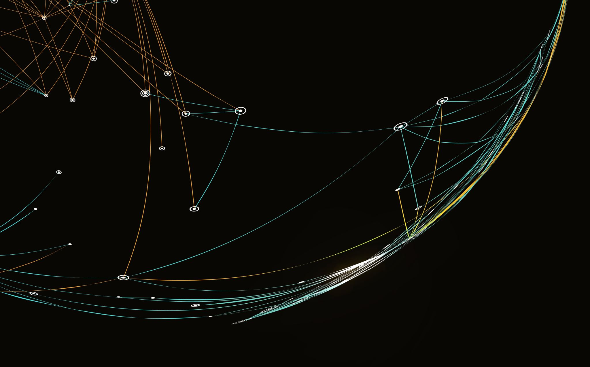
YOLO alternatives
Kalybek Aruzhan

Slide 2
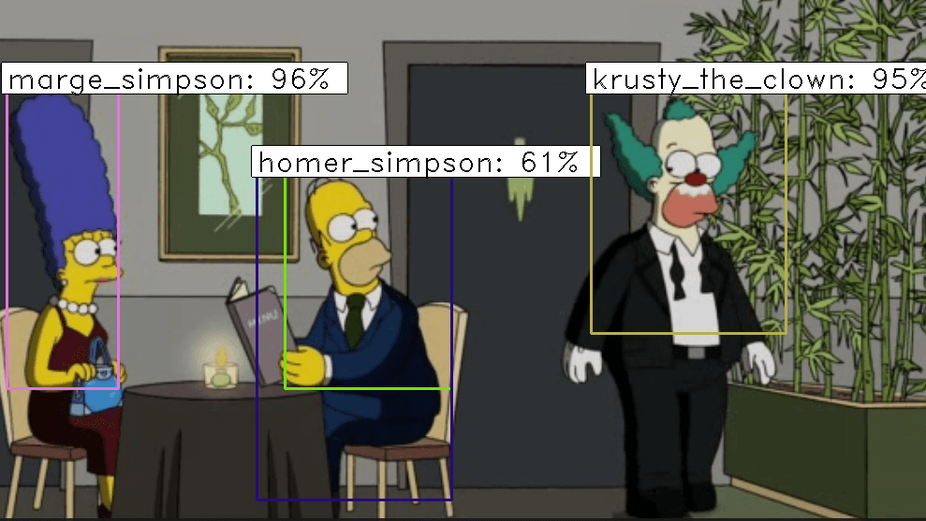
Introduction
YOLO (You Only Look Once) is a family of models for real-time object detection. YOLO processes an image in a single pass through the neural network, dividing it into a grid and predicting object coordinates, classes, and confidence scores.
Why YOLO is popular in object detection tasks?
YOLO is popular due to its high speed (processes images in a single pass), good accuracy, versatility (works on various devices), ease of training, and flexibility (suitable for tasks like tracking, segmentation, and object counting). New versions continue to improve, balancing speed and quality.

Slide 3
Main YOLO alternatives
CenterNet
Faster
R-CNN
SSD
EfficientDet
DETR

Slide 4
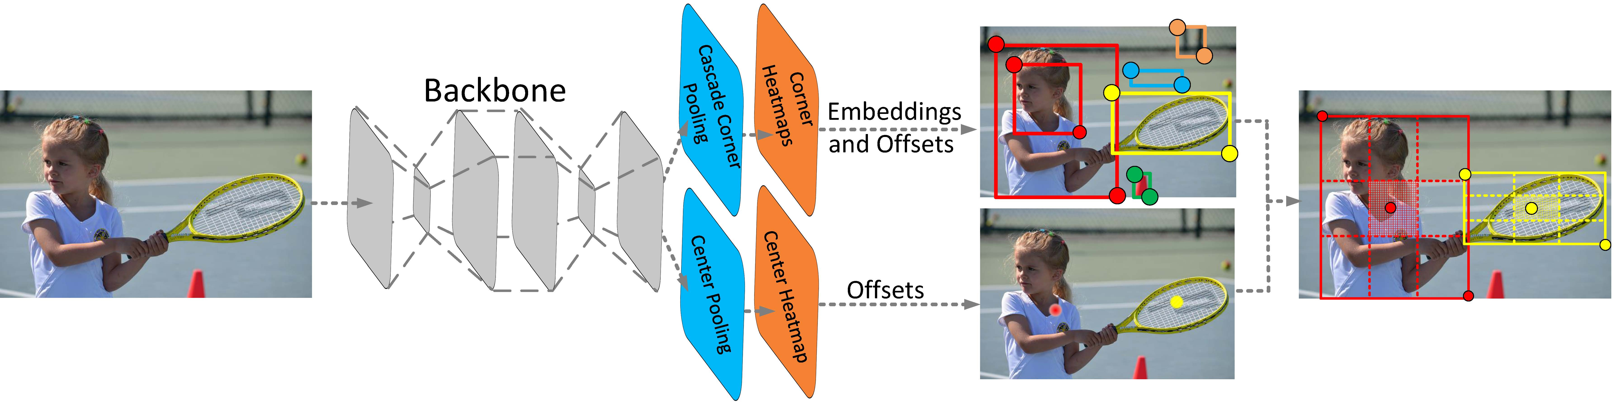
CenterNet is one of the best YOLO Alternatives for Real-Time Object Detection and is considered the best deep-learning model to predict the center of objects and attributes. It uses a heat maps-based approach to deliver accuracy and efficiency.
Features:
It depends on the heatmap to find the object centers and attributes.
Predict the attribute size and position of the object.
Can handle different object types and orientations seamlessly.
Obtain accurate pixel-level alignment between different features and output masks.

Slide 5
centernet
Pros +++
It uses a heatmap-based approach to obtain accurate object detection.
It uses a unique approach to simplify object detection and attain efficient inference.
Cons - - -
It demands a lot of computational resources compared to other simpler models.
It contains extensive and diverse datasets but performs differently than expected.

Slide 6
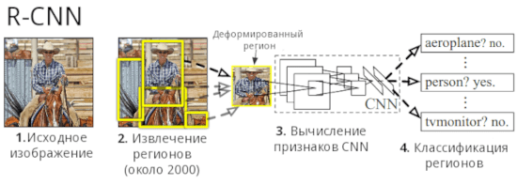
Faster R-CNN is one of the best object detection algorithms, and it uses a regional proposal network to generate object bounding boxes. It is highly accurate when region proposals and object classification are used.
Faster R-CNN will generate region proposals by checking the anchor boxes at different scales and aspect ratios.
It generates a two-stage detection pipeline where, in the first stage, it creates regional proposals, and in the second phase, it filters and classifies the proposals.
Extract fixed-size feature maps from the complex feature maps depending on the region proposals.
Handles the regions of different sizes and locations, making it invariant at various locations and scales

Slide 7
Faster r-cnn
Pros
Cons
Generate region proposals for different types of objects embedded in an image.
Have the ability to detect over 80 classes.
It takes a lot of time to detect objects.
The architecture used by this tool has some things that could be improved.

Slide 8
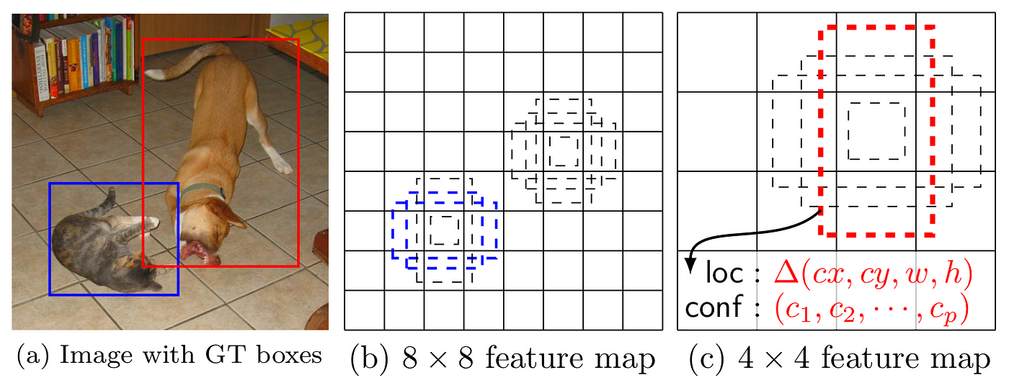
SSD, also known as Single Shot multibox detector, uses a deep learning model to detect objects in real time. It is one of the YOLO Alternatives for Real-Time Object Detection that gives high accuracy and efficiency using a single neural network to predict accurate locations of objects.
SSD object detection anchor boxes that serve the network to predict accurate object locations and sizes.
Contains feature maps of different resolutions extracted from various stages of the network
Every feature map is linked to the detection head to predict object class scores.
Acquire information from different feature maps to detect objects of varying sizes.

Slide 9
SSD
Pros +++
Cons - - -
Detects objects in real-time, making it ideal for use in apps with latency requirements.
It does object classification and localization at the same time attain higher SSD efficiency.
SSD performs great on different object sizes but performs poorly on smaller objects.
Many datasets are required to obtain accurate results with SSD.

Slide 10
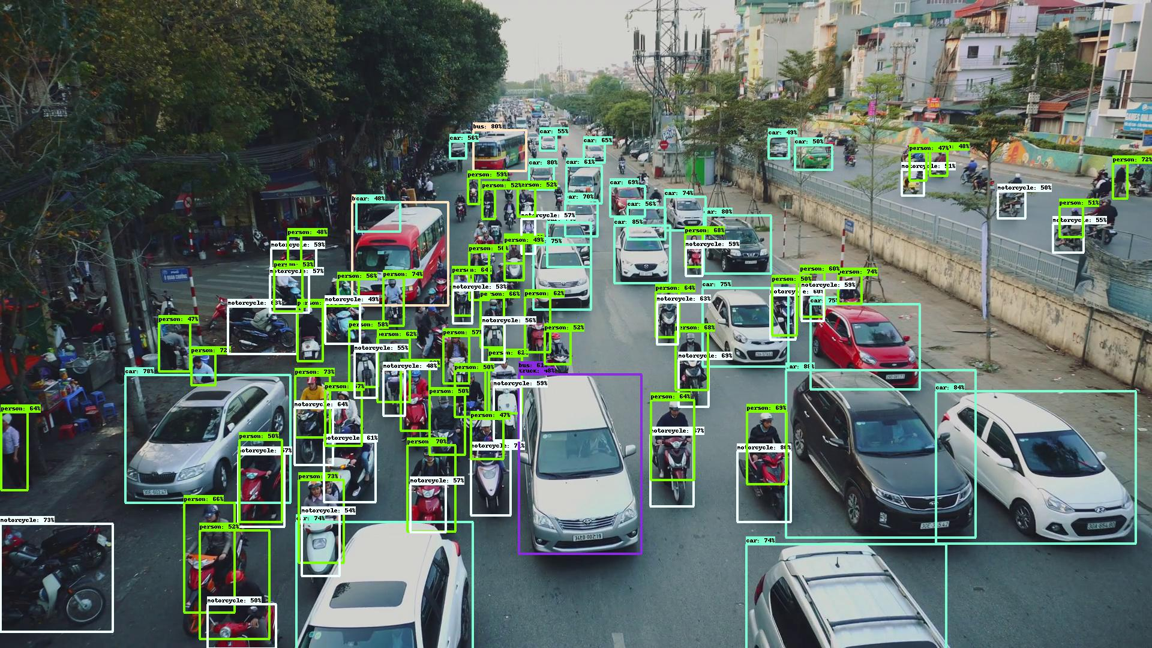
EfficientDet is one of the best YOLO Alternatives for Real-Time Object Detection that balances accuracy and efficiency. It demonstrates excellent performance on different object detection benchmarks.
Models developed are highly efficient and scalable to attain balance in the model size.
Use compound scaling technique to optimize depth, width, and resolution.
Highly efficient and accurate in detecting objects from images.
Use multi-scale feature fusion technique to capture and combine features at multiple scales.
+++Boost detection of objects of different sizes and handle objects with varying scale variations.
+++Handles challenging object detection scenarios efficiently.
- - - It consumes a lot of computational resources to train and fine-tune models.
- - - To achieve optimal results, you will need well-labeled training data.

Slide 11
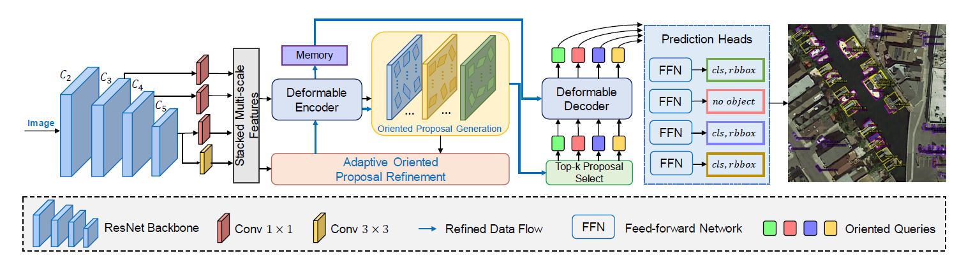
DETR is the best object detection deep learning algorithm that plays a crucial role in computer vision. It uses transformers' power to predict object classes and bounding boxes.
Apply transformers to detect objects seamlessly.
It uses self-attention to process the images holistically.
Predicts the position of objects and corresponding classes from the input image.
Eliminate the need for anchor boxes to streamline the detection process.
+++Use transformer-based architecture to detect objects accurately.
+++Have the capability to handle overlapping objects easily.
- - - Computationally, it is expensive to attain optimal performance.
- - - Using large amounts of datasets and smaller datasets leads to suboptimal performance.

Slide 12
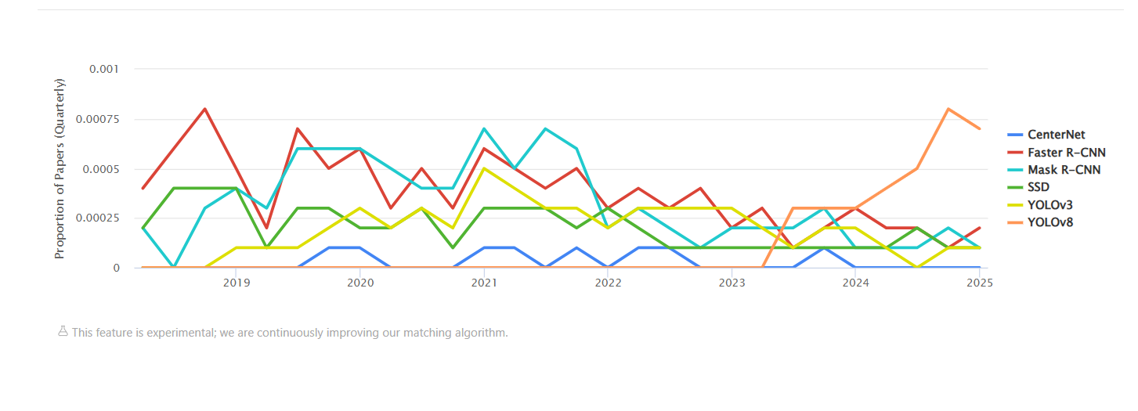
Usage over time

Slide 13
Model | Architecture | Accuracy | Speed | Pros | Cons
YOLO | Single-pass CNN | High (lower than Faster R-CNN) | Very High | Fast, versatile, easy to train | May be less accurate than complex models
DETR | Transformer-based | High | Low | High accuracy, no need for anchors, handles overlapping objects well | Requires large datasets, computationally expensive
CenterNet | Heatmap-based | High | Medium | Simple architecture, precise object center detection | High computational cost
EfficientDet | CNN with compound scaling | High | High | Scalable, efficient for detecting objects of various sizes | Requires powerful resources for training
Faster R-CNN | Two-stage R-CNN | Very High | Low | High accuracy, good for detecting small objects | Slow, complex to configure
SSD | Single-pass CNN | Medium | High | Good speed, performs classification and localization simultaneously | Struggles with small object detection

Slide 14
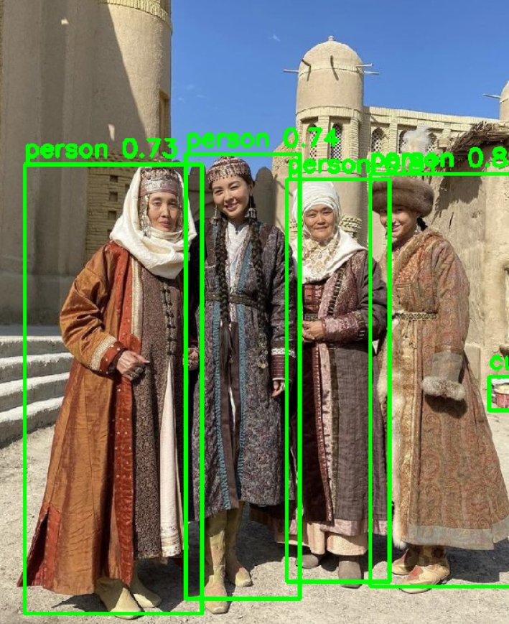
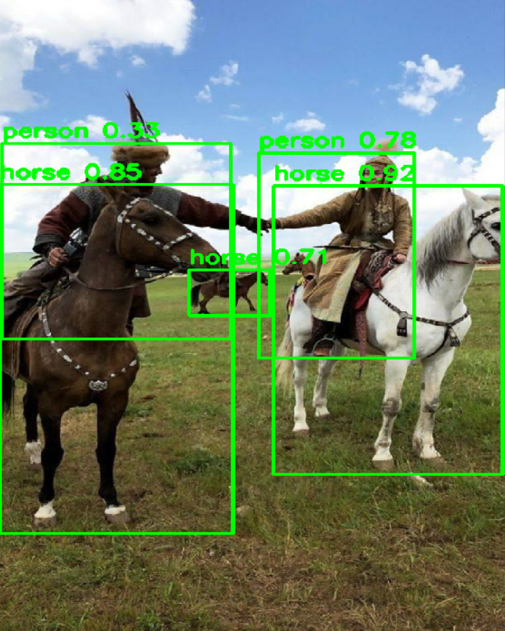
Yolo example

Slide 15
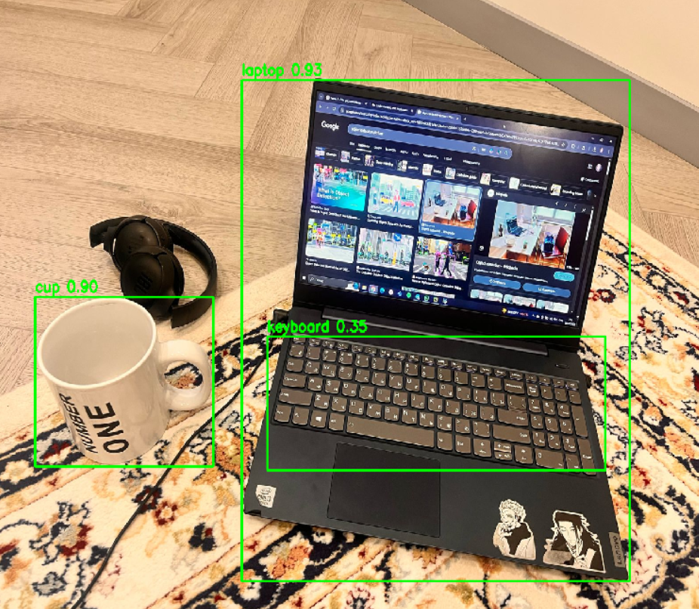
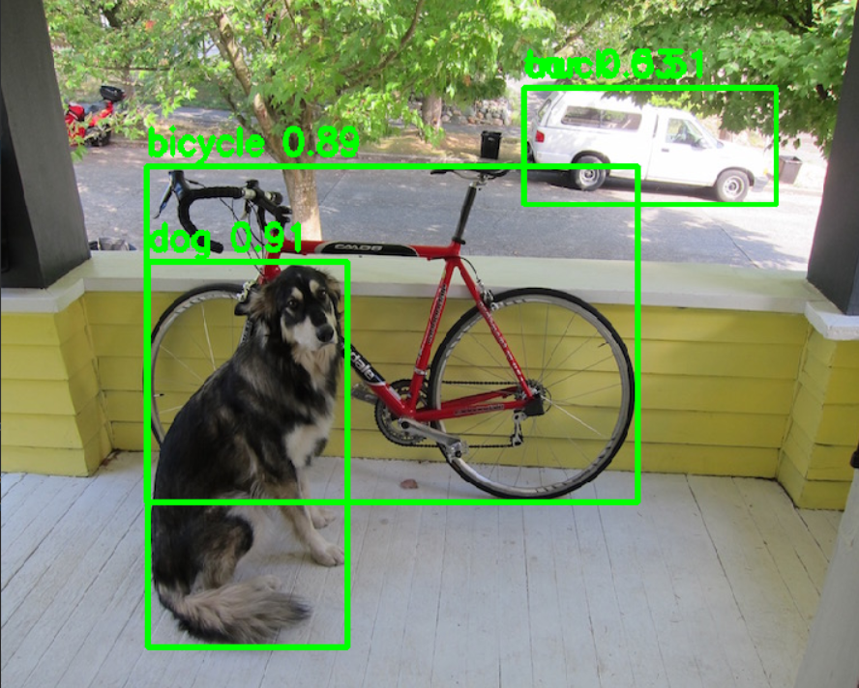
YOLO EXAMPLE

Slide 16
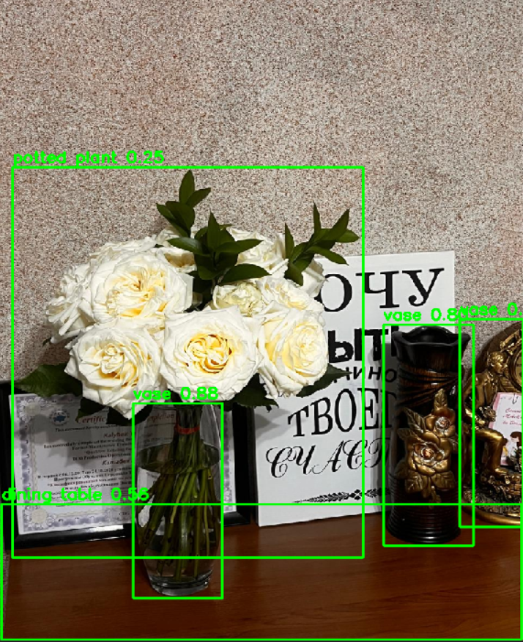
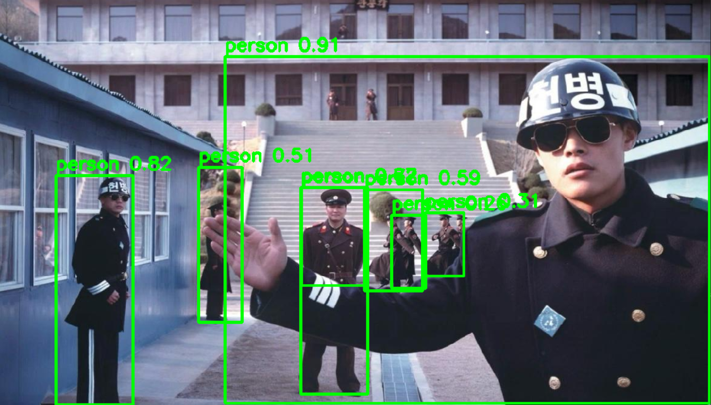
YOLO EXAMPLE

Slide 17
conclusion
YOLO & SSD → Best for real-time applications.
Faster R-CNN & DETR → Best for high-accuracy tasks.
EfficientDet → Balanced choice for efficiency and scalability.
CenterNet → Accurate but computationally expensive.

Slide 18
Thanks for attention!
Kalybek Aruzhan

